Slide 1
ServerWiz2 Overview
Serverwiz2 is a hierarchically based XML editor that is targeted for representing a system topology.
It has 3 primary concepts:
  Instances
    Node, card, connector, or chip
    Chips can have units that specify subcomponents of that chip such as cores and bus interfaces
  Busses/Connections
    A connection between 2 units of Instances
    Connections are made at the level in the hierarchy where they exist in the real system
  Attributes
    Instances and Connections both have attributes
    Attributes are variables that Hostboot reads to control the behavior

Slide 2
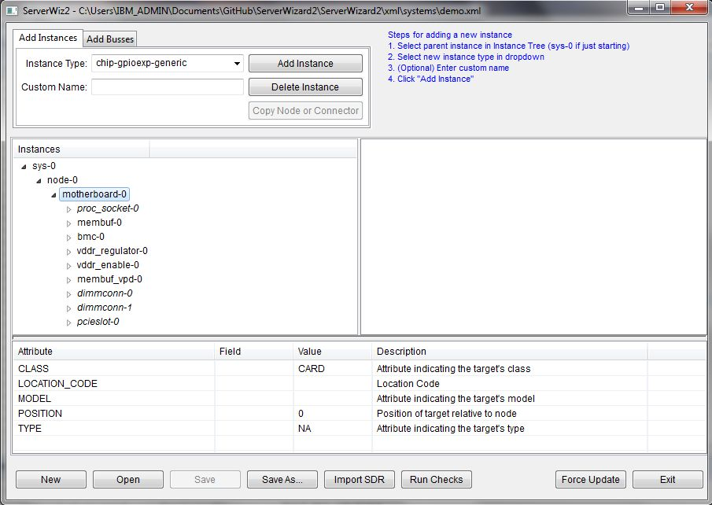
Instance Creation
Step 2: Select type of new instance.
Only valid children will be visible
Step 4: Click “Add Instance”
Step 3 (optional): Enter custom name
Step 1: Select parent of new instance
Select Instance to view attributes

Slide 3
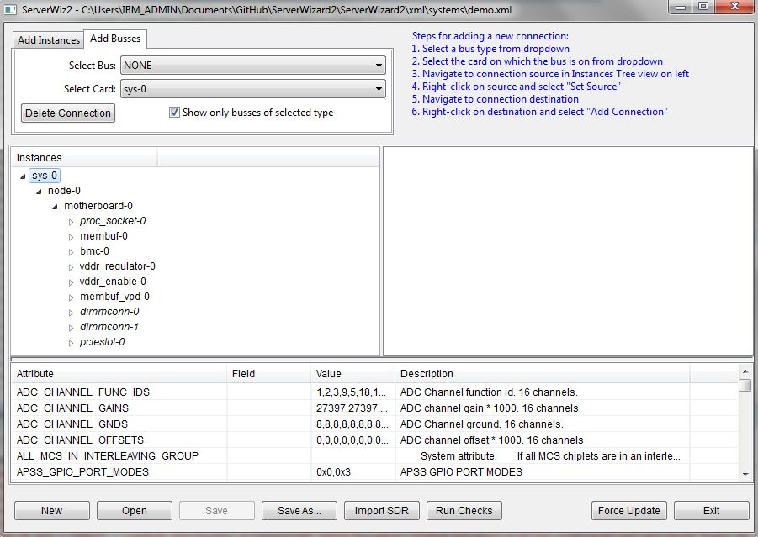
Connection Creation
1. Select Bus mode
2. Select Bus type
3. Select level in hierarchy
On which connection exists
(more about this on next page)

Slide 4
Connection Hierarchy
Connections must be created at highest common point in hierarchy or physically where wire exists. Here are some examples:
  Simple single motherboard system
    All connections are created at motherboard level so Selected Card = motherboard.
    The motherboard is also obviously where the physical wires exist
  System with memory riser cards
    The DMI bus spans the motherboard and riser card
    The motherboard level is selected because that is the highest common level in the hierarchy
  Multi-node system with cables connecting nodes
    System level is selected because that is highest common level in hierarchy

Slide 5
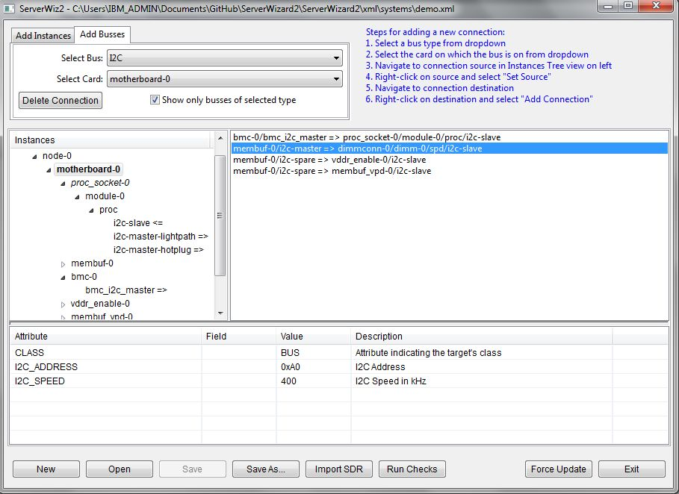
Connection will
Exist on motherboard
I2C bus type
Motherboard level is automatically highlighted and expanded
Destinations show ‘<=‘
Source show ‘=>’

Slide 6
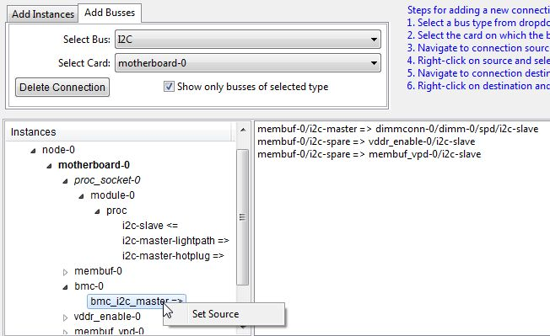
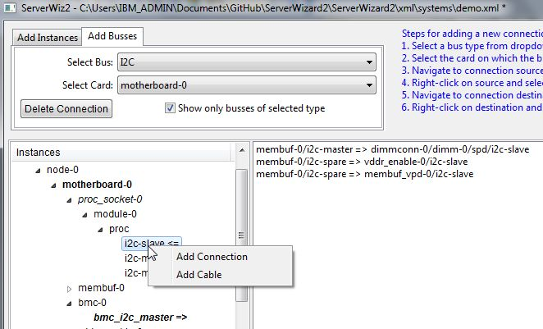
To start a connection,
Right click on source and
select “Set Source”
To create connection,
Right click on destination
And select “Add Connection”

Slide 7
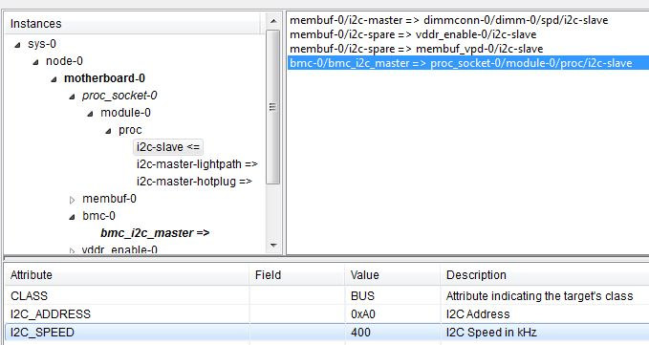
New Connection
Shows here
Select connection to
View attributes. For example,
An I2C bus has an address and speed.

Slide 8
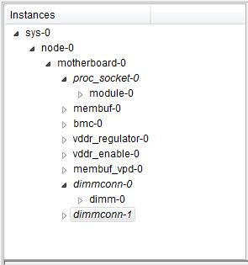
Minimum System Requirements
System is always top level
Node is always second level
A System typically has a main board or motherboard
Must have at least 1 processor socket and processor chip
Must have at least 1 memory buffer
Must have 1 and only 1 BMC
Must have at least 1 VDDR regulator
(hostboot controls enable and must be aware of topology)
Must have at least 1 GPIO expander that controls VDDR
regulator enable
Must have at least 1 VPD for storing memory wiring information
Must have at least 1 part of DIMM connectors and DIMMs

Slide 9
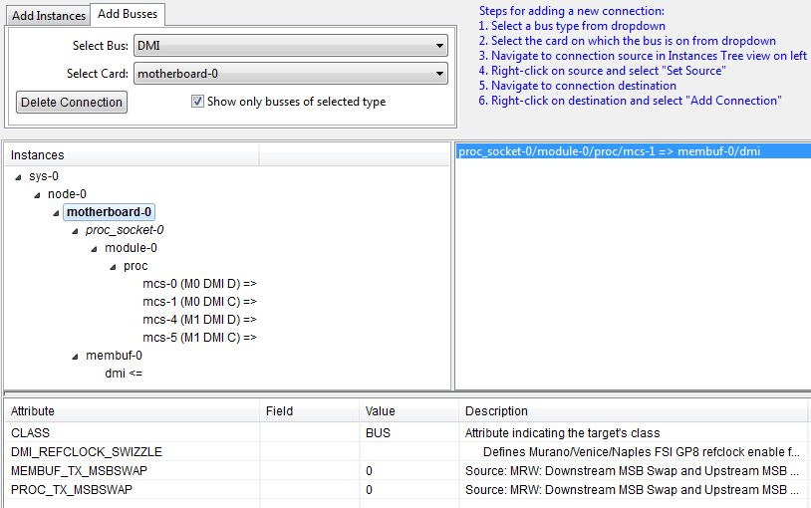
DMI
Required Connections: All membuf’s must have a DMI connection to a CPU
The DMI name in the parenthesis match the schematic names
If there is an lane reversal in the design, change the MSBSWAP attributes below to “1”.

Slide 10
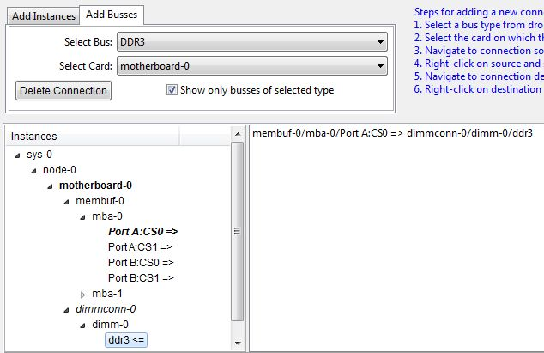
DDR
Required Connections: All DIMMs must be connected to a membuf
The names for the DDR ports match schematic names. Make sure DIMM naming convention and connections match schematic. It will make the I2C connections more straightforward.

Slide 11
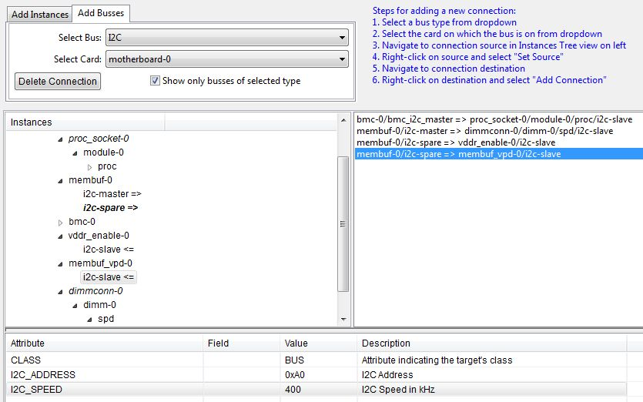
I2C
Required connections:
  BMC to CPU I2C slave for OCC communication
  Membuf I2C connections to DIMMs SPD
  Membuf I2C connection to GPIO expander to VDDR enable
  Membuf or CPU I2C connection to VPD
For I2C busses, make sure I2C_ADDRESS and I2C_SPEED attributes match the design

Slide 12
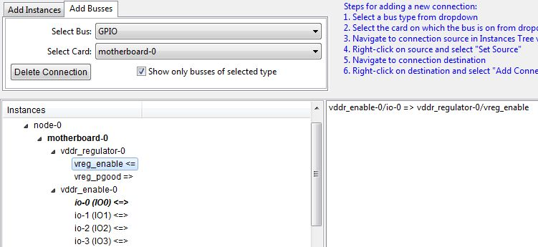
GPIO
Required Connection: GPIO expander that controls the VDDR regulator enable. The GPIO port # from GPIO expander must match design.

Slide 13
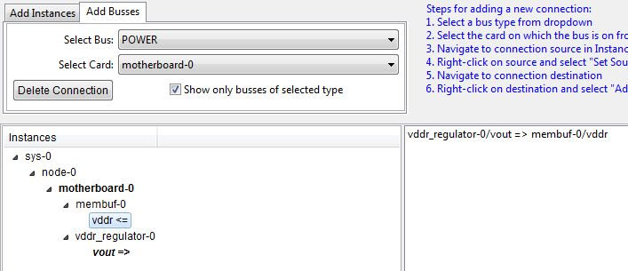
Power
Required Connections: VDDR regulator connection to membuf

Slide 14
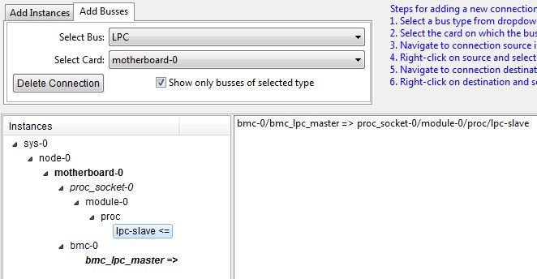
LPC Bus
Required connection: The LPC bus connection between the BMC and one of the CPU’s tells Hostboot which CPU is the master.

Slide 15
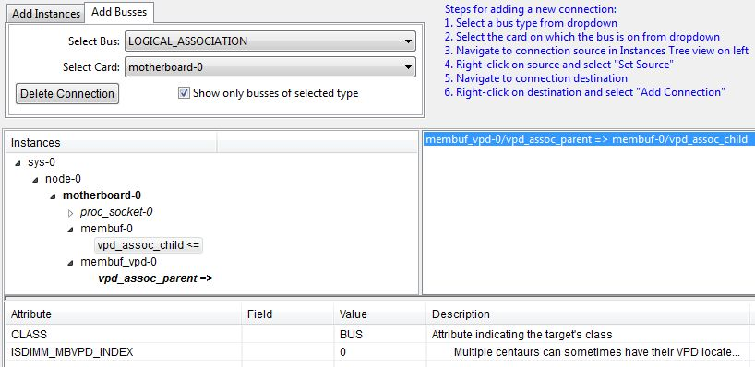
Logical Association
Required connections: VPD that contains membuf wiring information connection to membuf
This is a virtual connection that tells hostboot where the VPD exists for each membuf. The VPD can alternatively be attached to the CPU I2C master
This logical association concept could be extended to FRU LED associations

Slide 16
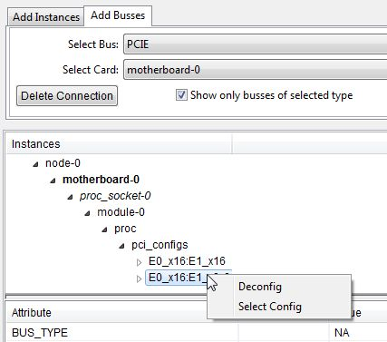
PCIe
The PCIe bus is unique in that it can be configured in several different ways. Under the “pci_configs” parent, you will see the various configurations. To choose one, right-click and select “Select Config”. The other configurations will be hidden. To make all configurations visible, right-click and select “Deconfig”.

Slide 17
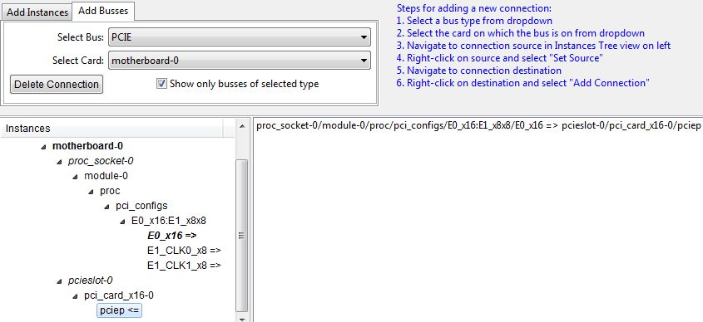
PCIe
Required Connections: None
Here is an example where E0 is configured as a x16 and E1 is configured as 2 x8’s.

Slide 18
Serverwiz Library Files
Every 3 days, Serverwiz will check the XML files at:
  https://github.com/open-power/serverwiz/tree/master/xml
  If the files have change, it will prompt the user if they wish to download new files
Description of Files:
  attribute_types.xml, attribute_types_hb.xml, attribute_types_mrw.xml
    Listing of all possible attributes including data type, default value, and description
    Attribute_type.xml and attribute_types_hb.xml are same as hostboot
  target_types_mrw.xml
    Describes all the possible instances, the type of the instance, and the associated attributes
    Systems, chips, cards, etc
    Also describes the valid parent instance types
  target_instances_v3.xml
    Specific instances of a target types including attribute values and children

Slide 19
Making Changes
Additions of attributes might occur because of new Hostboot requirements or features
The change must first be thought of from a end user point of view (system designer/user of Serverwiz)
  1. If the attribute is a simple value that the user can enter directly then the developer must simply add the attribute into Serverwiz’s attribute_types.xml and target_types_mrw.xml under appropriate target. The attribute will then show up in the Serverwiz and the user can enter desired value.
  2. If the attribute is a computed value based on several factors, then the handling of the attribute must be in processMrw.pl
    If the computed valued depends on static values that are also new attributes, then follow Step 1.

Slide 20
IPMI Sensor Overview
The POWER BIOS (Hostboot, OCC, and OPAL) updates virtual BMC sensors via IPMI set sensor commands. The BIOS has to be informed of the IPMI sensor ID’s. It does so through IPMI_SENSORS attribute.
Serverwiz can import XML (which could be generated by BMC development environment) that contains the sensor information using the “Import SDR” button and populate the IPMI_SENSORS attribute
There is a strict mapping between the instance type and the IPMI entity ID. The mapping is maintained in the ENTITY_ID_LOOKUP attribute which is read-only (see Table on next page)
The Serverwiz IPMI_INSTANCE attribute maps to the IPMI entity instance in the SDR import XML. The user must make sure the IPMI_INSTANCE attribute is unique per entity ID.

Slide 21
Entity ID Mapping
Sensor Name | Entity ID | Sensor Type Code | Target Association
CPU Temperature | 0x03 | 0x01 | proc
CPU Core Temperature | 0xD0 | 0x01 | core
CPU Functional Status | 0x03 | 0x07 | proc
CPU Core Functional Status | 0xD0 | 0x07 | core
CPU Core Frequency | 0xD0 | 0xC1 | core
Memory Buffer Temperature | 0xD1 | 0x01 | membuf
DIMM Temperatur | 0x20 | 0x01 | dimm
Memory Buffer Functional | 0xD1 | 0x0C | membuf
DIMM Functional Status | 0x20 | 0x0C | dimm
DIMM Frequency | 0x08 | 0xC1 | system
Backplane Fault | 0x07 | 0xC7 | node
System Event | 0x01 | 0x12 | system
Host Status | 0x23 | 0x22 | system
Firmware Boot Progress | 0x22 | 0x0F | system
PCIe Link Present | 0x23 | 0xC4 | system
OS Boot Status | 0x23 | 0x1F | system
OCC Active | 0xD2 | 0x07 | occ
Power Cap | 0x17 | 0xC2 | system
Boot Count | 0x22 | 0xC3 | system
System Power Limit (User set) | 0x15 | 0xC2 | system
Activate Power Limit | 0x15 | 0xC6 | system
APSS_Channel | 0xD7 | 0xC2 | system
* Entity Instance from SDR maps to IPMI_INSTANCE attribute

Slide 22
SDR XML Format
<devices>
  <device>
    <name>Name</name>
    <dev_name>Secondary Name</dev_name>
    <sensor_id>[Sensor ID in decimal]</sensor_id>
    <entity_id>[Entity ID in hex]</entity_id>
    <sensor_type>[Sensor type in hex]</sensor_type>
    <entity_instance>[Instance number in hex]</entity_instance>
  </device>
  …
</devices>
When the “Import SDR” button is used in Serverwiz, it will import a file of this format. It will attempt to match up the entity id from the ENTITY_ID_LOOKUP under a given target and the IPMI_INSTANCE attribute to the entity_id and entity_instance fields from the SDR import file.

